Slide 1
Conjoint Analysis in R
Aamir Salaam
Date: Oct 07, 2012

Slide 2

Business Problems
Which new products have a high success rate in the market?
Which product features or attributes drive purchase decisions?
What advertising messages will be appealing to consumers?
What is the optimal price for a product / service?

Slide 3

Solution - Conjoint Analysis
Conjoint Analysis is a statistical technique used in market research
Determines how people value different product features and attributes
Trade-offs are evaluated by jointly considering a number of important attributes
Objective is to find the most influential attributes of a product
How important is the brand of bottled water?
VS
Do you prefer bottled water with brand A and price X or bottled water with brand B and price Y?

Slide 4
Conjoint Analysis Example – Tea Data
Attribute | Level
Price ($) | Low, Medium, High
Variety (V) | Black, Green, Red
Kind (K) | Bags, Granulated, Leafy
Aroma (A) | Yes, No
# of survey product profiles: 13
# of survey respondents: 100
Survey Respondent | Product Profile #1 $_{high}, V_{black}, K_{bags}, A_{yes} | Product Profile #2 $_{low}, V_{green}, K_{bags}, A_{yes} | ...
respondent # 1 | 8 | 1 | ...
respondent # 2 | 1 | 10 | ...
... | ... | ... | ...
respondent # 100 | 9 | 7 | ...
Notes:
What tea attributes are important?
What combination of attributes and levels provide the best value?
What is the market segmentation?
What is the market share simulation of profiles?

Slide 5
Conjoint Code
library(conjoint)
data(tea)
# ---------------------------------------------------------------------
# tpref : rank response data from the survey
# from 1 (least prefer) to 10 (most prefer)
# 1300 x 1
# tprof : tea profiles attributes --> Price, Variety, Kind, Aroma
# 13 x 4
# tlevn : levels of each attribute
# 11 x 1
# ---------------------------------------------------------------------
# (1) main results of the conjoint analysis
res = Conjoint(tpref, tprof, tlevn)
# (2) returns the importance of each attribute
imp = caImportance(tpref, tprof)
# (3) respondents cluster / segmentation
segments = caSegmentation(tpref, tprof, 4)

Slide 6
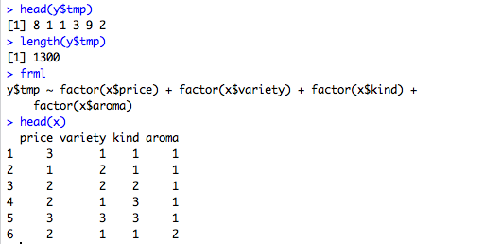
Math behind Conjoint

Slide 7
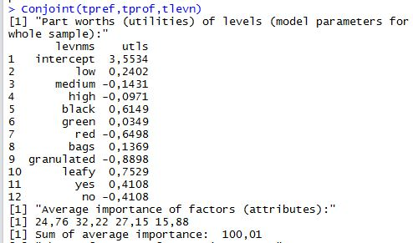
Conjoint Linear Regression Results
Price
Variety
Kind
Aroma

Slide 8
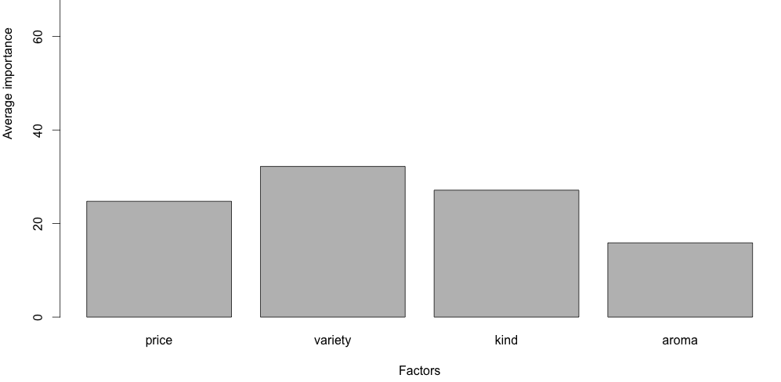
Result Analysis

Slide 9
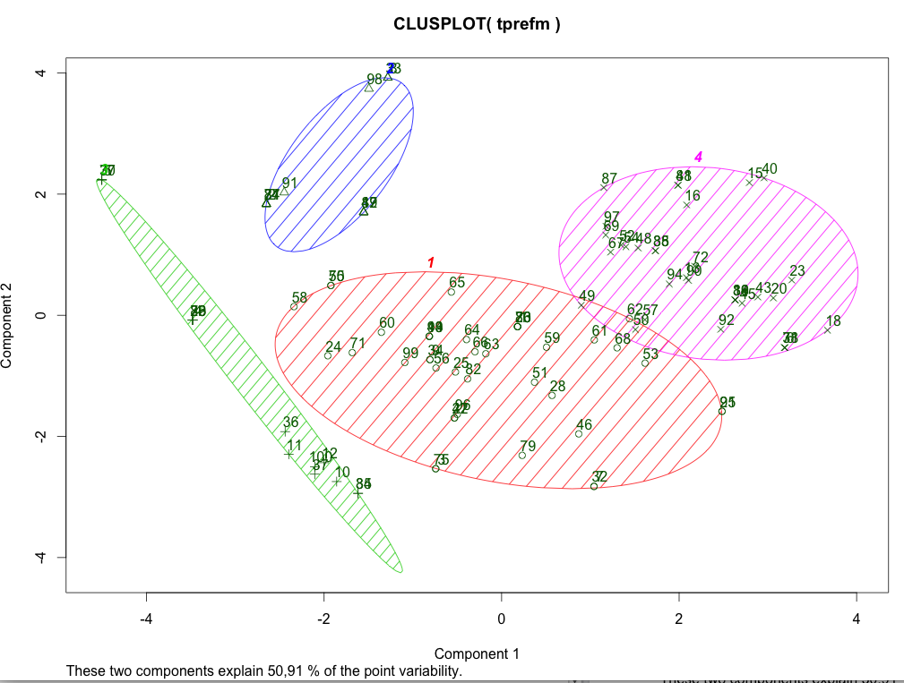
Cluster Analysis
Notes:
fit = kmeans(tprefm, 4)
fit$size
fit$centers
plot(tprefm, col=fit$cluster)
d = dist(tprefm, method="euclidian")
fit_h = hclust(d, method="ward")
names(fit_h)
plot(fit_h, main="Tea Cluster")
groups = cutree(fit_h, k=4)
rect.hclust(fit_h, k=4, border="blue")
library(cluster)
c_d = clusplot(tprefm, groups, color=TRUE, shade=TRUE, labels=2, lines=0)

